Slide 1
PHYS4260 Quantum Mechanics II Spring 2025
Symmetries and Conservation laws

Slide 2
Outline
Heisenberg Picture
Schrödinger Picture
Invariance under time translations

Slide 3
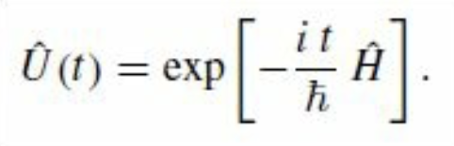
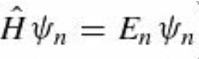
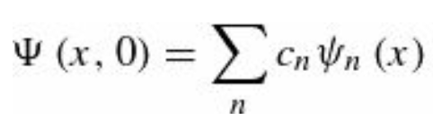
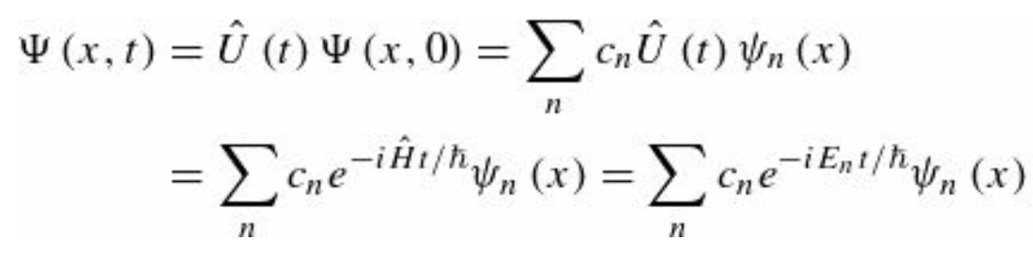
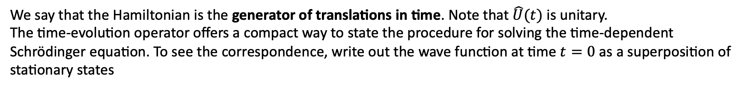
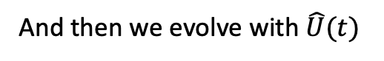
Recap: Translations in Time
Therefore, in the case of a time-independent Hamiltonian, the time-evolution operator is
We say that the Hamiltonian is the generator of translations in time. Note that $\hat{U}(t)$ is unitary.
The time-evolution operator offers a compact way to state the procedure for solving the time-dependent Schrödinger equation. To see the correspondence, write out the wave function at time $t=0$ as a superposition of stationary states
And then we evolve with $\hat{U}(t)$
Here we are expanding the initial wave function in terms of stationary states and then tacking on the “wiggle factors”
to obtain the wave function at a later time.

Slide 4
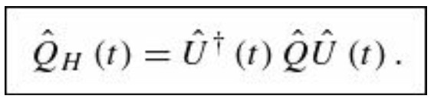
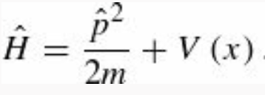
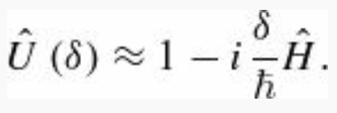
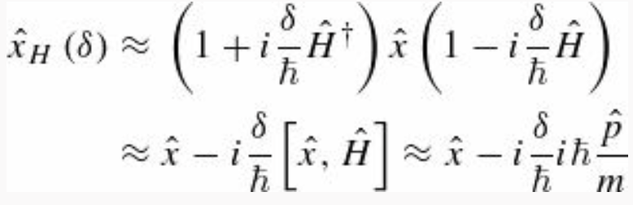
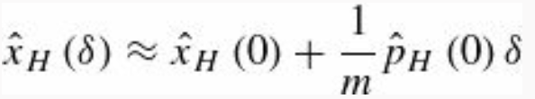
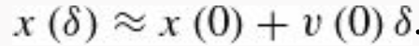
Recap: The Heisenberg Picture
We can examine the effect of applying time-translation to operators, as well as to wave functions. The transformed operators are called Heisenberg-picture operators, and we follow the convention of giving them a subscript H rather than a prime
EXAMPLE 1. A particle of mass m moves in one dimension in a potential $V(x)$. We want to find the position operator in the Heisenberg picture for an infinitesimal time translation $δ$. SOLUTION:
Therefore, we can write
Wow! This looks exactly like classical mechanics

Slide 5
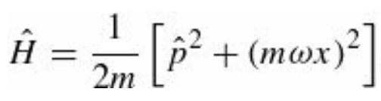
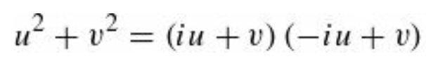
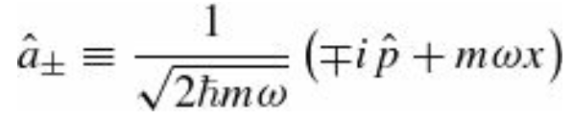
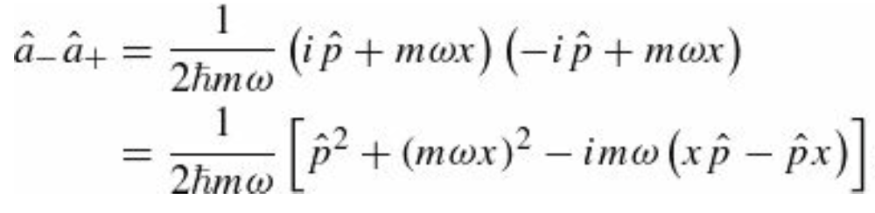
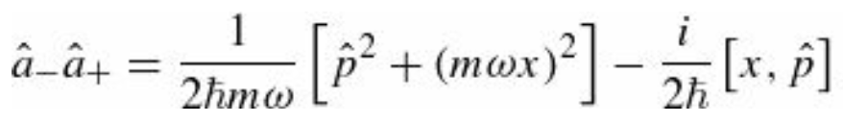
The Heisenberg Picture
EXAMPLE 2. A particle of mass m moves in one dimension in a harmonic-oscillator potential:
Find the position operator in the Heisenberg picture at time t.
Solution. Remember that in the case of the simple harmonic oscillator we could rewrite
Using and assuming that u and v do not commute, one can define the ladder operators

Slide 6
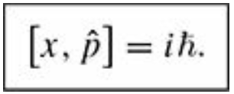
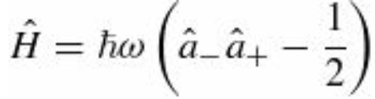
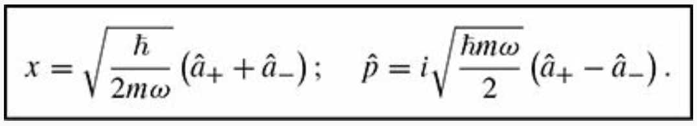
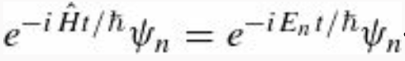
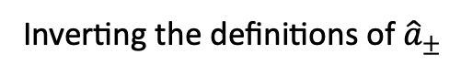
The Heisenberg Picture
Using the differential operator definition for $\hat{p}$ and acting on generical functions one can see that
Inverting the definitions of ${\hat{a}}_{±}$
Now we are in position to tackle the problem. Consider the action of ${\hat{x}}_{H}$ on stationary states $ψ_{n}$

Slide 7
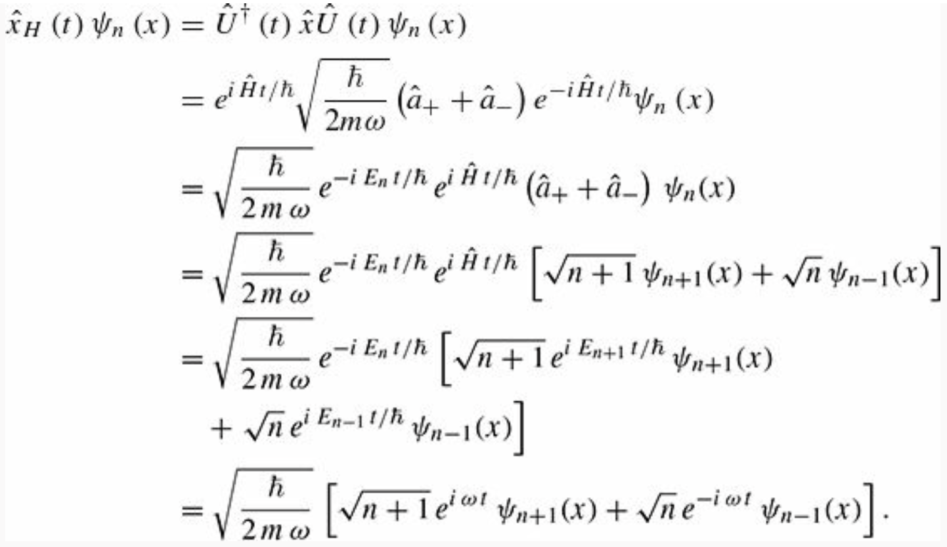
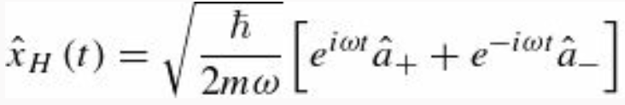
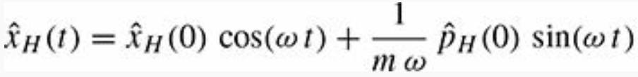
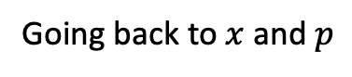
The Heisenberg Picture
Therefore, we obtain
Wow! The Heisenberg-picture operator satisfies
the classical equation of motion for a mass on a spring!
The Heisenberg picture illuminates the connection
between classical and quantum mechanics:
the quantum operators obey the classical equations
of motion.
We use the relation
from Ch2
Going back to $x$ and $p$

Slide 8
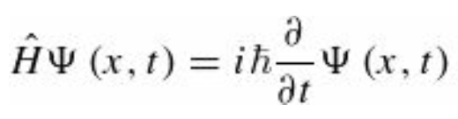
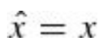
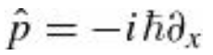
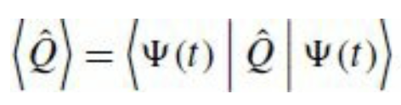
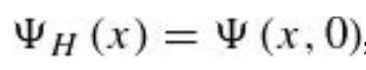
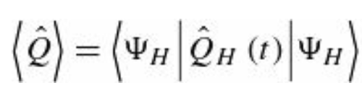
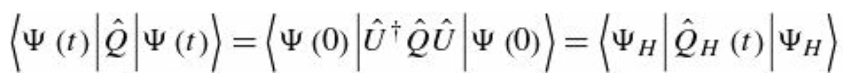
The Schrödinger Picture
Besides the Heisenberg picture, there is the Schrödinger picture, so-named by Dirac because it was the picture that Schrödinger himself had in mind. In the Schrödinger picture, the wave function evolves in time according to the Schrödinger equation
have no time dependence of their own, and the time dependence of expectation values (or, more generally, matrix elements) comes from the time dependence of the wave function
In the Heisenberg picture, the wave function is constant in time , and the operators evolve in time.
In the Heisenberg picture, the time dependence of expectation values (or matrix elements) is carried by the operators.
Of course, the two pictures are entirely equivalent since

Slide 9
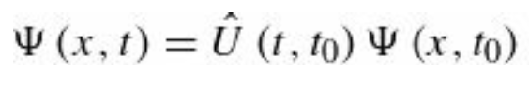
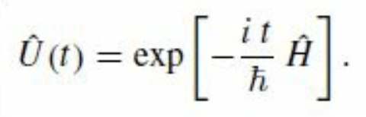
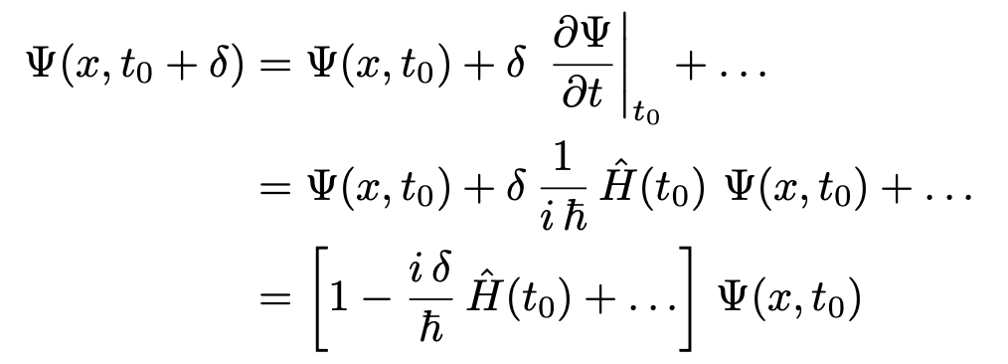
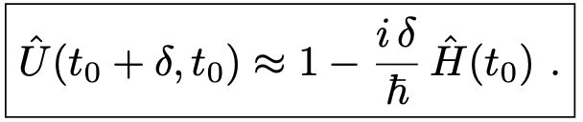

Time translation invariance
If the Hamiltonian is time-dependent one can still write the formal solution to the Schrödinger equation in terms of the time-translation operator $\hat{U}$
But $\hat{U}$no longer takes the simple form
However, using a Taylor expansion
Therefore, one can see that $Ψ\left(x,t\right)$ is a solution to the Schrödinger equation
for an infinitesimal time δ

Slide 10
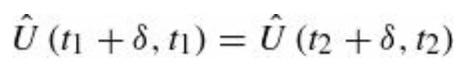
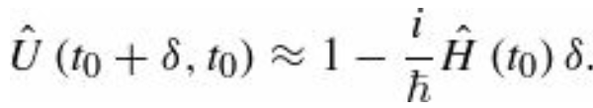
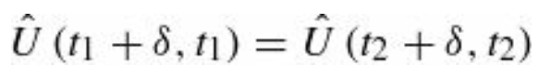
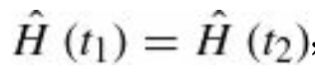
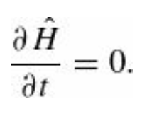
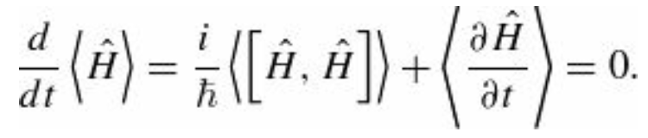

Time translation invariance
Time-translation invariance means that the time evolution is independent of which time interval we are considering.
In other words:
for any choice of t1 and t2. This ensures that if the system starts in state $\left.|α\right\rangle$ at time $t_{1}$ and evolves for a time δ then it will end up in the same state $|β$⟩ as if the system started in the same state $\left.|α\right\rangle$ at time $t_{2}$ and evolved for the same amount of time δ.
Plugging into the equation is satisfied only if
Since it must hold for all $t_{1}$ and $t_{2}$ , it must be that the Hamiltonian is in fact time-independent after all (for time-translation invariance to hold):
and
Therefore, energy conservation is a consequence of time-translation invariance.

Slide 11
Time-Independent Perturbation Theory
Outline
Nondegenerate Perturbation Theory
Degenerate Perturbation Theory
In QM, perturbation theory is a set of approximation schemes directly related to mathematical perturbation for describing a complicated quantum system in terms of a simpler one.
The idea is to start with a simple system for which a mathematical solution is known, and add an additional "perturbing" Hamiltonian representing a weak disturbance to the system

Slide 12
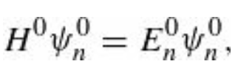
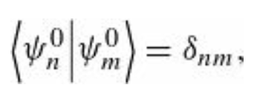
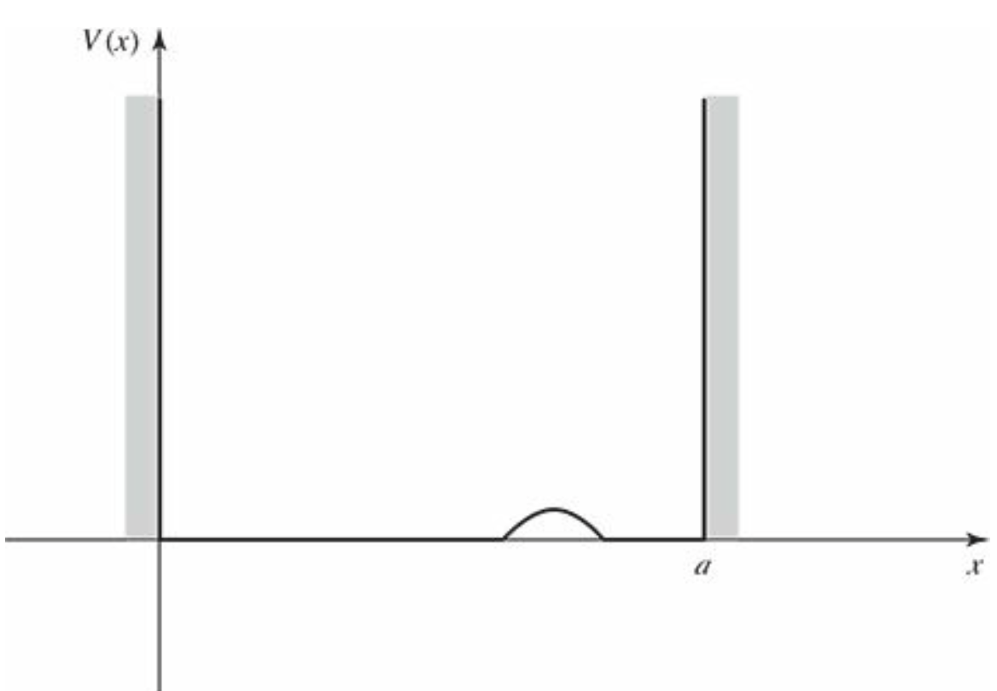
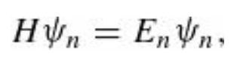

Nondegenerate Perturbation Theory
Suppose we have solved the (time-independent) Schrödinger equation for some potential (say, the one-dimensional infinite square well)
obtaining a complete set of orthonormal eigenfunctions with eigenvalues $E_{n}^{0}$.
Now we perturb the potential slightly (say, by putting a little bump in the bottom of the well).
We’d like to find the new eigenfunctions and eigenvalues:
The Schrödinger equation cannot be solved exactly, for this more complicated potential (in most cases).
Perturbation theory is a systematic procedure for obtaining approximate solutions to the perturbed problem, by building on the known exact solutions to the unperturbed case.

Slide 13
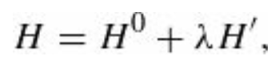
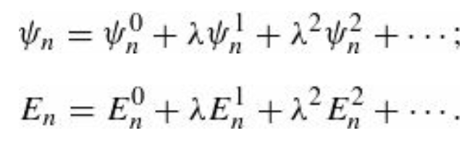
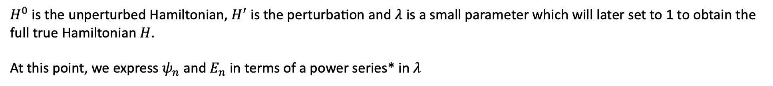

Nondegenerate Perturbation Theory
To begin with we write the new Hamiltonian as the sum of two terms:
$H^{0}$ is the unperturbed Hamiltonian, $H^{′}$ is the perturbation and $λ$ is a small parameter which will later set to 1 to obtain the
full true Hamiltonian $H$.
At this point, we express $ψ_{n}$ and $E_{n}$ in terms of a power series* in $λ$
$E_{n}^{1}$ is the first-order correction to the nth eigenvalue, and so on…
$ψ_{n}^{1}$ is the first-order correction to the nth eigenfunction, and so on…
*The existence of such an expansion requires that the perturbed solutions are smoothly connected to the unperturbed solutions, which is an assumption made here. Perturbation theory may fail, e.g., if a phase transition occurs.

Slide 14












Nondegenerate Perturbation Theory
Substituting the power series into
Collecting in $λ$
Equating powers of $λ$
We are done with $λ$. It was only a device to keep track of the
different orders*. Now we crank it up to 1.
$$λ^{0}$$
$$λ^{1}$$
*The powers of λ are linearly independent functions, so the only way that the above equation can be satisfied for all (arbitrary) values of λ is if the coefficient of each power of λ is 0.
$$λ^{2}$$

Slide 15





First-Order Theory
Taking the inner product of with $ψ_{n}^{0}$ we obtain
And using H Hermiticity
and this cancels the first term on the right. Moreover, and we finally obtain
This is the fundamental result of first-order perturbation theory; as a practical matter, it may well be the most frequently used equation in quantum mechanics. It says that the first-order correction to the energy is the expectation value of the perturbation, in the unperturbed state.

Slide 16



First-Order Theory: Example
The unperturbed wave functions for the infinite square well are
Suppose we perturb the system by simply raising the “floor” of the well a constant amount $V_{0}$.
Find the first-order correction to the energies.
In this case, $H′$=$V_{0}$ and the first-order correction to the energy of the nth state is

Slide 17



First-Order Theory: Example
The corrected energy levels, then, are $E_{n}≈E_{n}^{0}+V_{0}$ they are simply lifted by the amount $V_{0}$.
Of course! The only surprising thing is that in this case the first-order theory yields the exact answer.
Evidently for a constant perturbation all the higher corrections vanish. On the other hand, if the perturbation extends only half-way across the well, then
which is not the exact result.

Slide 18






First-Order Theory (1st order correction to $ψ$)
is the first-order correction to the energy; to find the first-order correction to the wave function we rewrite
The right side is a known function, so this amounts to an inhomogeneous differential equation for $ψ_{n}^{1}$ .
Now, the unperturbed wave functions constitute a complete set, so $ψ_{n}^{1}$ (like any other function) can be expressed as a linear combination of them:
The requirement $m≠n$ is because the eigenfunctions in the set must be linearly independent. In addition, one observes that
for $m=n$ , $ψ_{n}^{1}$ is a solution and so is $ψ_{n}^{1}+α$ $ψ_{n}^{0}$ for any constant α, and we can use this freedom to subtract off the $ψ_{n}^{0}$ term.
If we could determine the coefficients $c_{m}^{(n)}$ we would be done. Substituting $ψ_{n}^{1}$ into the equation above we get

Slide 19









First-Order Theory
Taking the inner product with $ψ_{l}^{0}$ we obtain
$n=l$ $→$ the left side is zero, and we recover
$n≠l$ $→$ we obtain
The denominator is safe (since there is no
coefficient with $m=n$) as long as the
unperturbed spectrum is nondegenerate.
But if two different unperturbed states shared
the same energy, we would be in serious trouble
This implies that

Slide 20




Second-Order Energies
Proceeding as before, we take the inner product of the second-order equation with with $ψ_{n}^{0}$
and obtain
$H^{0}$ is Hermitian and
So, the first term on the left cancels the first term on the right. Meanwhile, and we are left with

Slide 21



Second-Order Energies
We also know from before that
And this implies that
This is the fundamental result of second-order perturbation theory. One can continue with this method and generate higher-order corrections to the wave functions and energy. But after the third order things get involved and one needs more powerful methods (e.g., Dalgarno-Lewis method, or the “logarithmic” perturbation theory)

Slide 22



Degenerate Perturbation Theory
If the unperturbed states are degenerate—that is, if two (or more) distinct states e.g., $ψ_{n}^{0}$ and $ψ_{m}^{0}$, that share the same energy, then ordinary perturbation theory fails
$$∞$$
$$∞$$
unless the numerator itself goes to zero.
As we have anticipated, this is a typical case in which degeneracy induces infinities in the theory, and therefore, the theory must be amended to deal with degeneracy.
In the degenerate case, there is no reason to trust even the first-order correction to the energy, and we must look for some other way to handle the problem.
Note that this is not a minor problem; almost all applications of perturbation theory involve degeneracy.

